Slide 1
Course Name: Fundamentals of Investment
Week 1: The Investment Environment

Slide 2
Course Learning Objectives
The learning objectives of a fundamentals of investment course typically include:
1. Understanding investment principles: Learners should grasp fundamental concepts such as risk, return, time value of money, and diversification.
2. Analyzing investment opportunities: Learners should be able to evaluate various investment options, including stocks, bonds, mutual funds, real estate, and alternative investments.
3. Constructing investment portfolios: Learners should learn how to design investment portfolios that align with their financial goals, risk tolerance, and time horizon.
4. Assessing risk and return: Participants should be able to assess the risk-return tradeoff of different investment choices and understand how risk affects investment performance.
5.Applying investment strategies: Learners should gain practical knowledge of investment strategies such as value investing, growth investing, income investing, and market timing.
6.Understanding market dynamics: Learners should comprehend the functioning of financial markets, including market efficiency, investor behavior, and the impact of economic factors on investment decisions.
7.Practicing investment analysis: Learners should develop skills in financial analysis, including reading financial statements, analyzing company performance, and conducting valuation
8. Investor Protection: Learners should develop awareness about the investor protection laws and role of various bodies in investor interest protection and grievance handling. They should also gain knowledge about investor awareness and activism.

Slide 3
Week 1: Learning Objectives
The basic objective is to understand the investment environment in terms of identifying the components of the financial system, types of investments and concepts of risk and return etc.

Slide 4
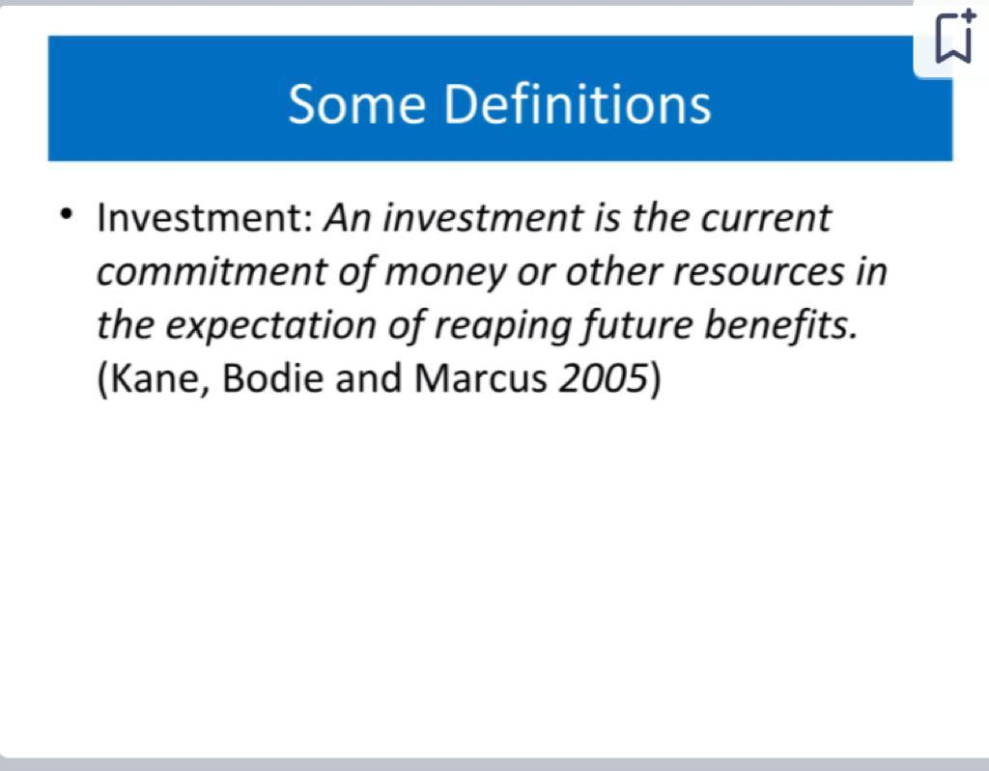

B.Com (H) VI Semester Fundamentals of Investment

Slide 5
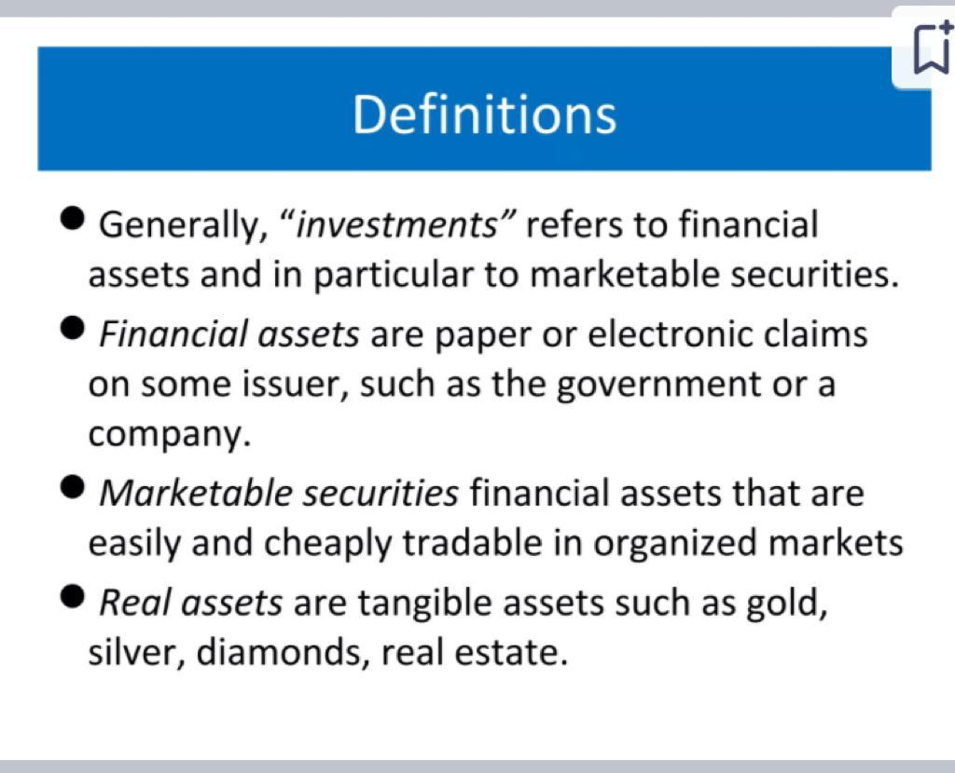
B.Com (H) VI Semester Fundamentals of Investment

Slide 6
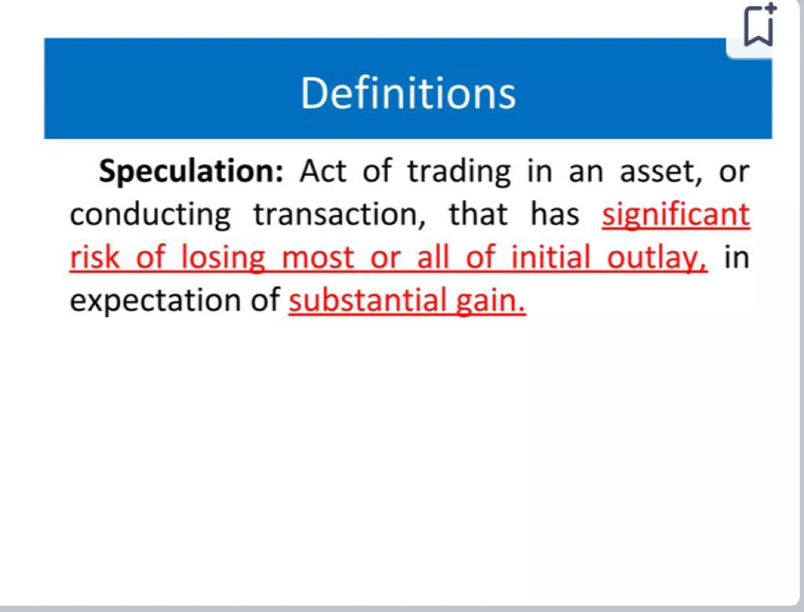
B.Com (H) VI Semester Fundamentals of Investment

Slide 7
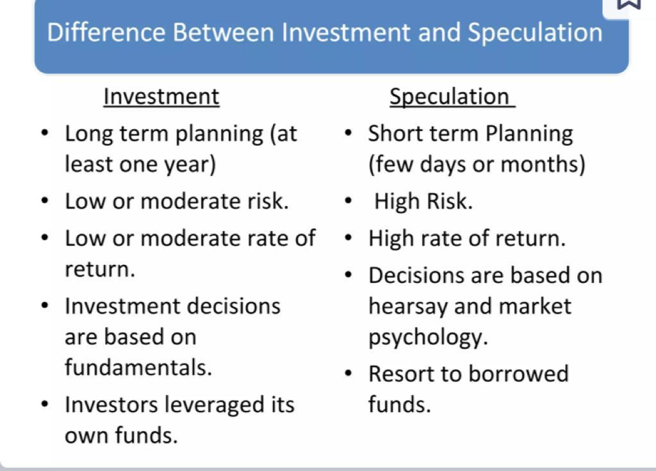
B.Com (H) VI Semester Fundamentals of Investment

Slide 8
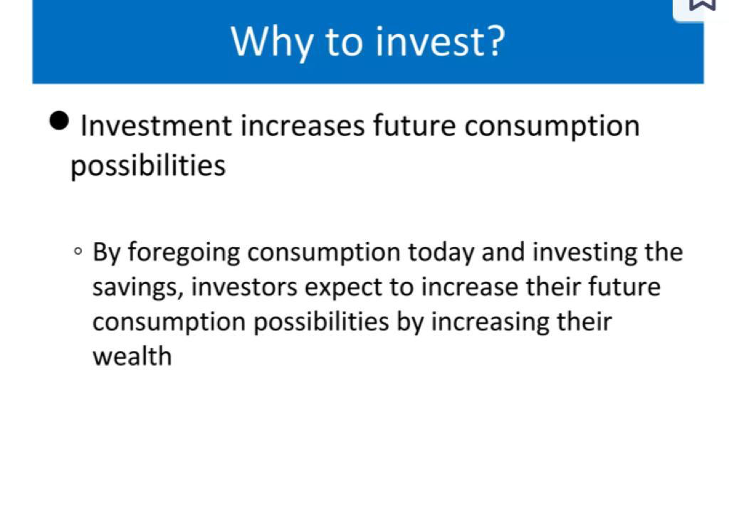
B.Com (H) VI Semester Fundamentals of Investment

Slide 9
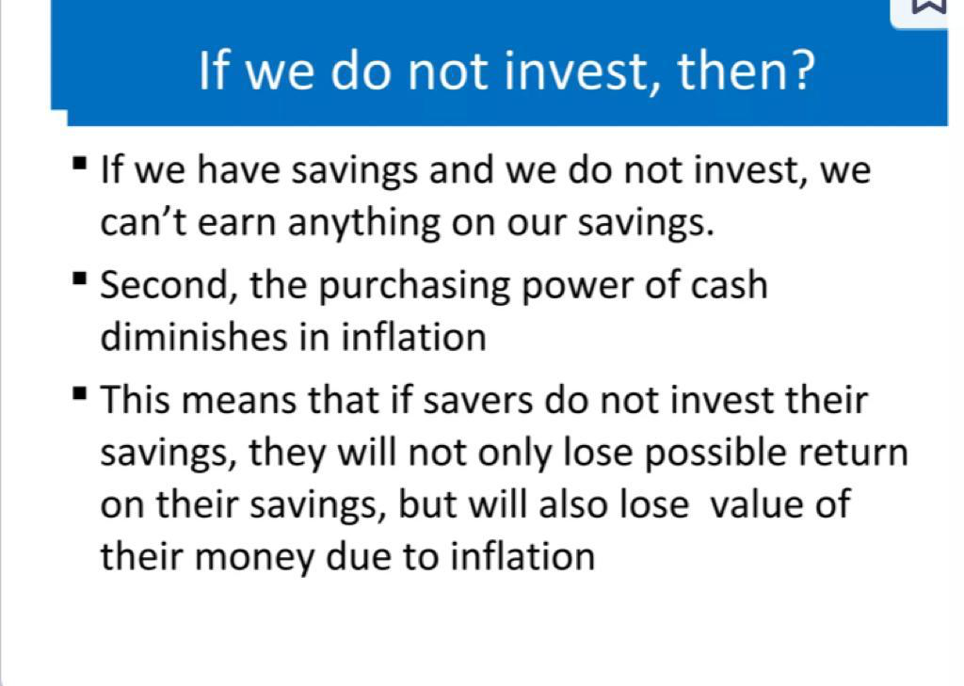
B.Com (H) VI Semester Fundamentals of Investment

Slide 10
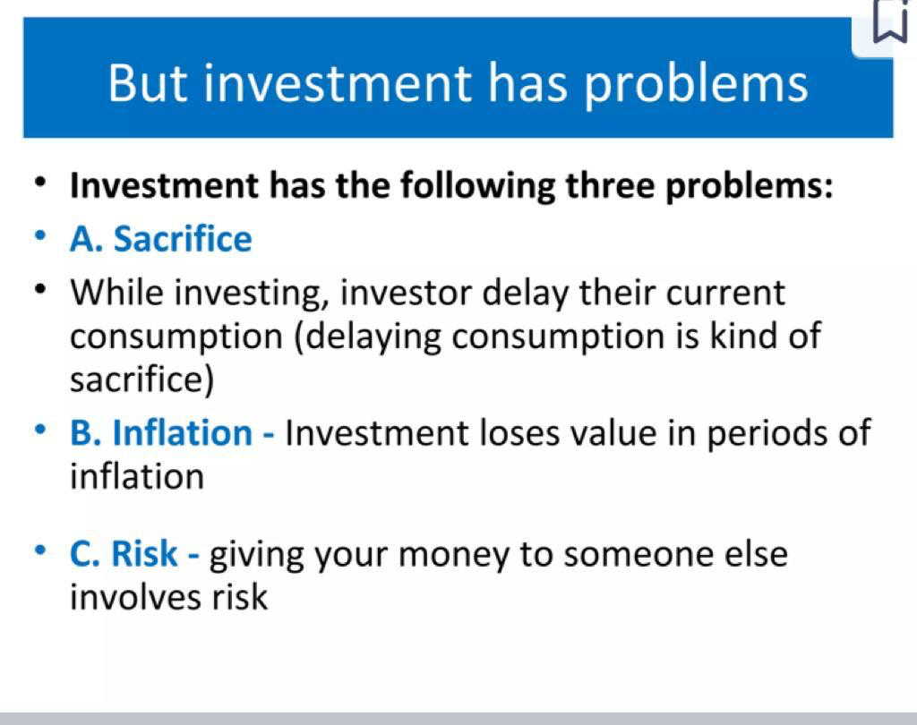
B.Com (H) VI Semester Fundamentals of Investment

Slide 11
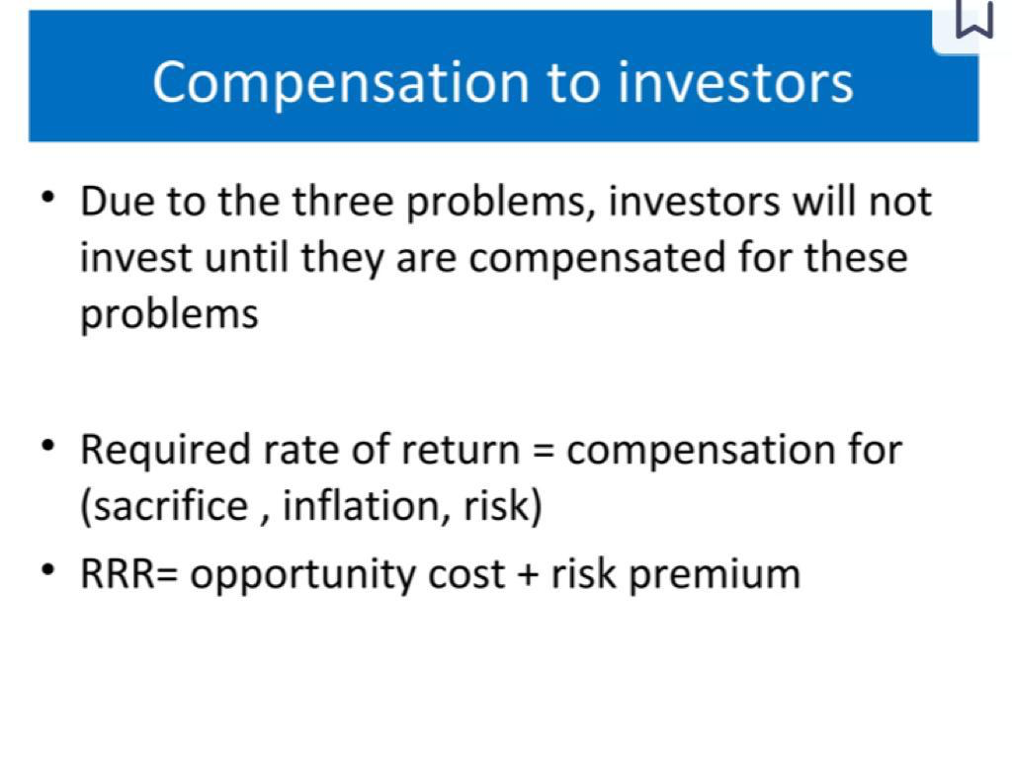
B.Com (H) VI Semester Fundamentals of Investment

Slide 12
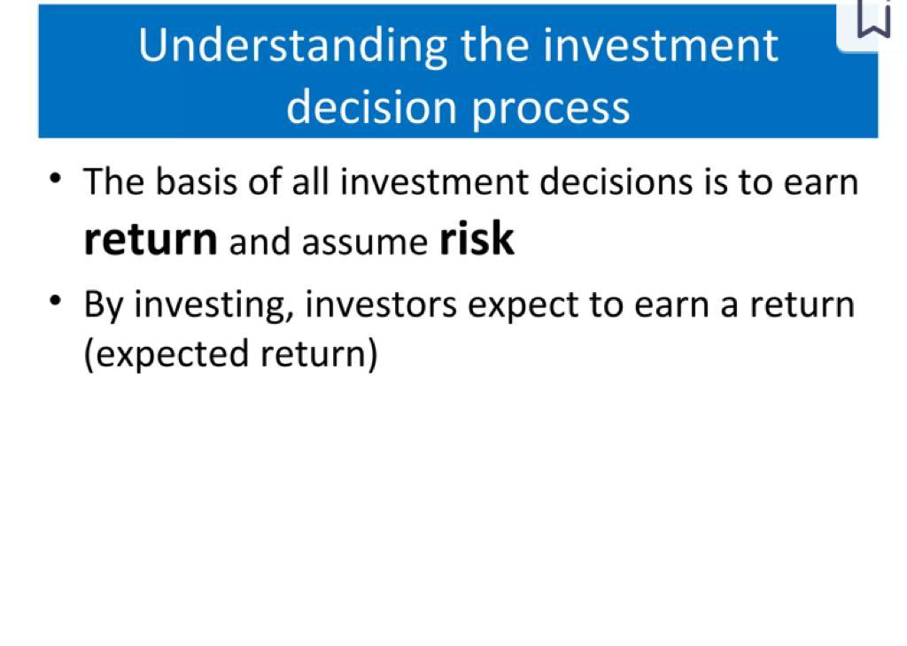
B.Com (H) VI Semester Fundamentals of Investment

Slide 13
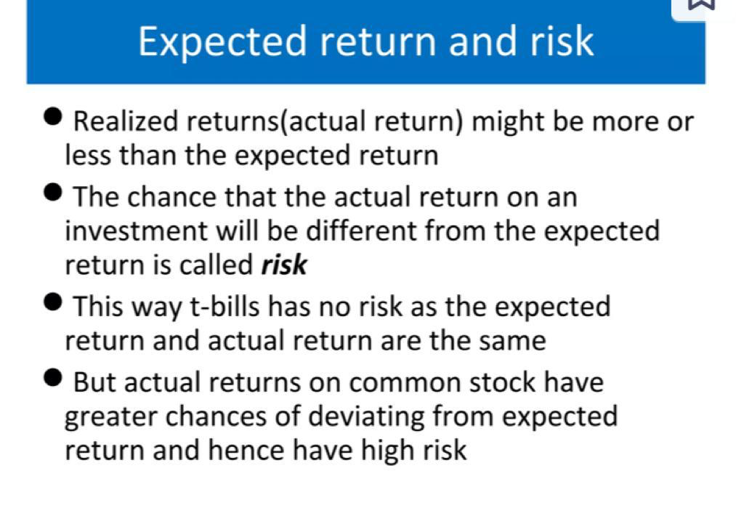
B.Com (H) VI Semester Fundamentals of Investment

Slide 14
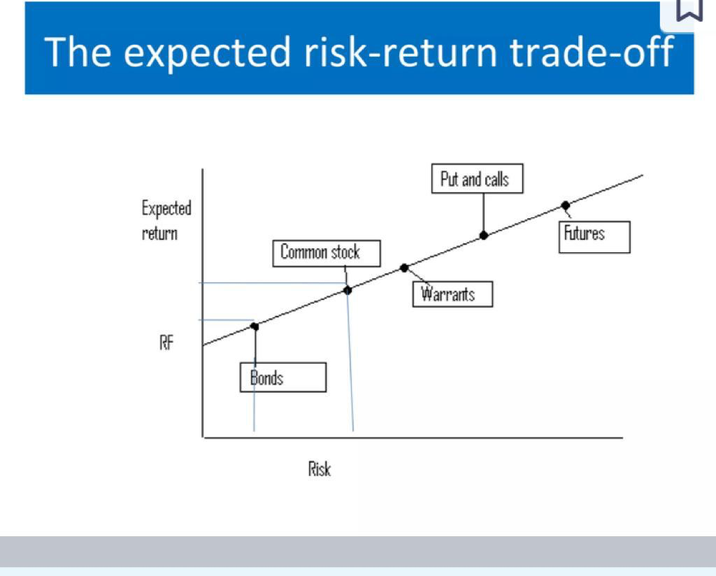
B.Com (H) VI Semester Fundamentals of Investment

Slide 15
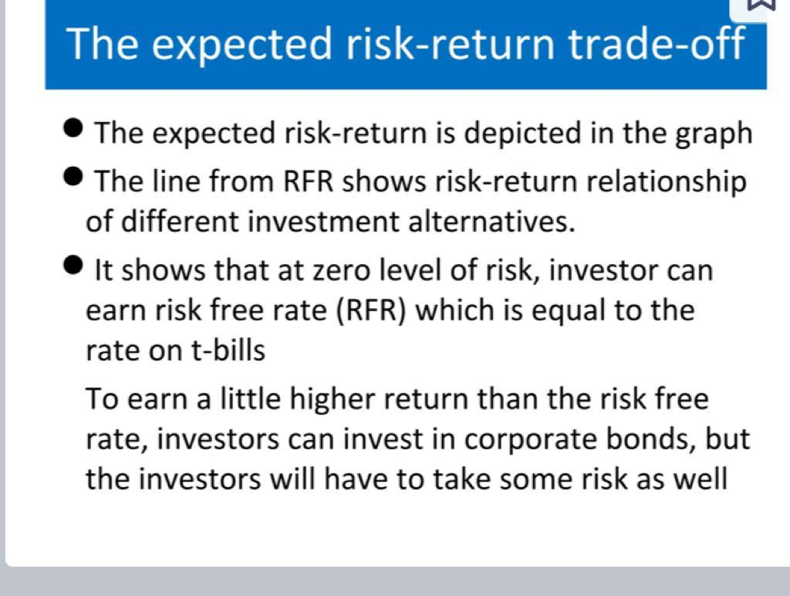
B.Com (H) VI Semester Fundamentals of Investment

Slide 16
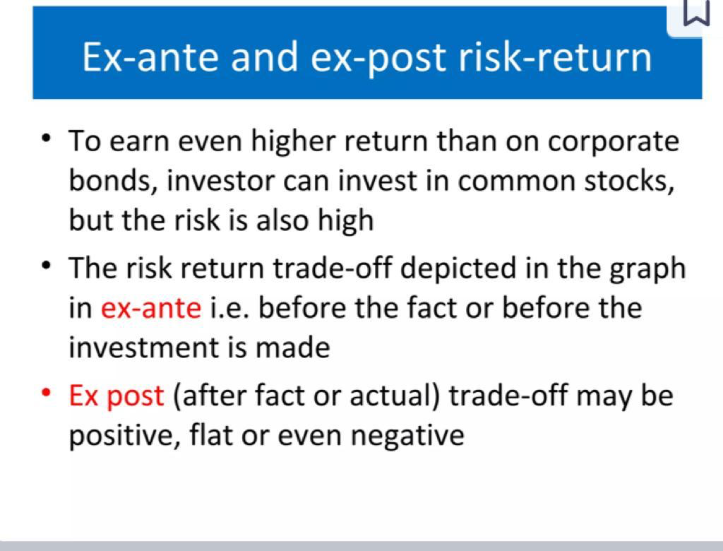
B.Com (H) VI Semester Fundamentals of Investment

Slide 17
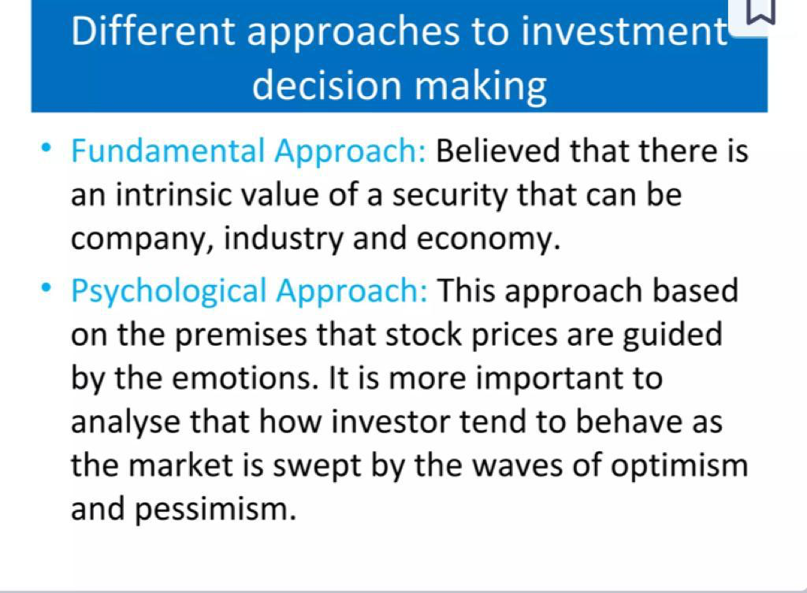
B.Com (H) VI Semester Fundamentals of Investment

Slide 18
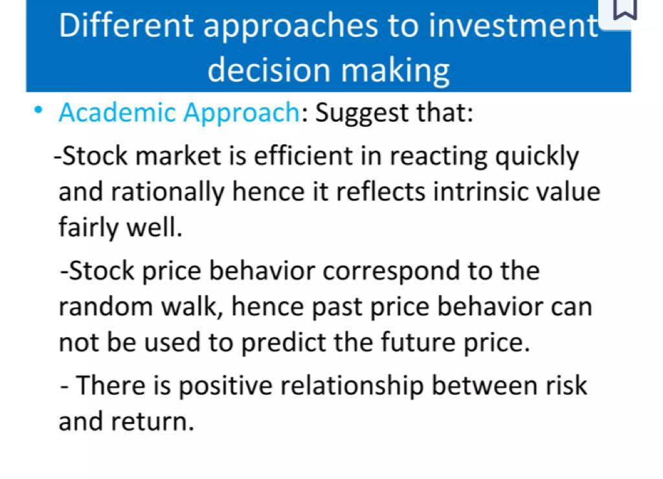
B.Com (H) VI Semester Fundamentals of Investment

Slide 19
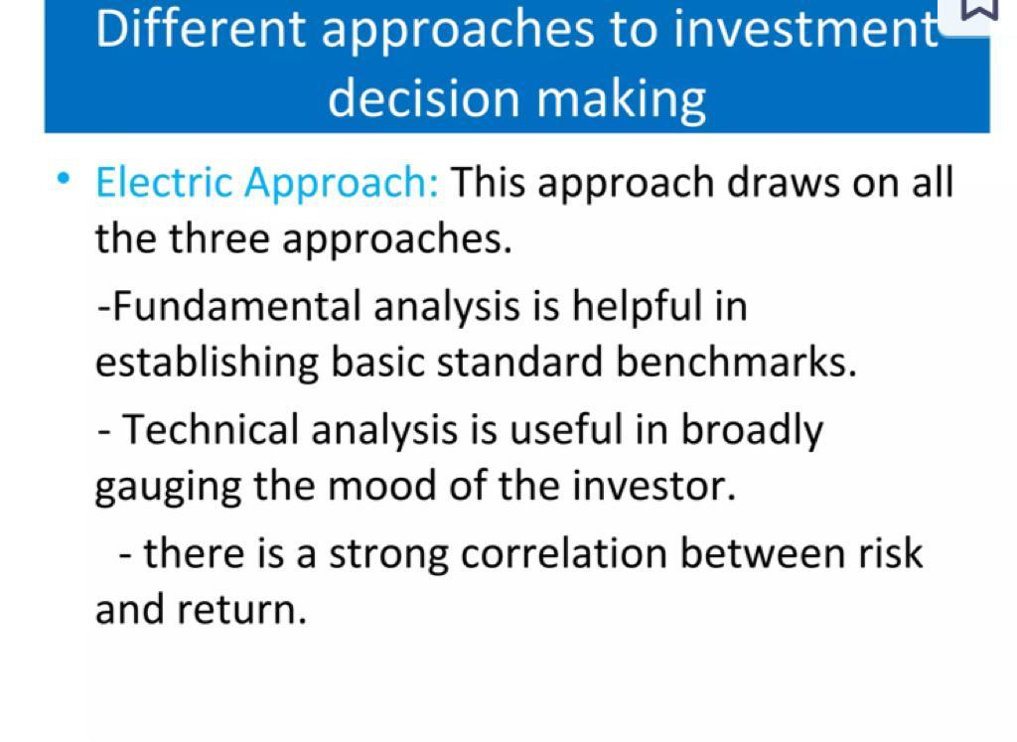
B.Com (H) VI Semester Fundamentals of Investment

Slide 20
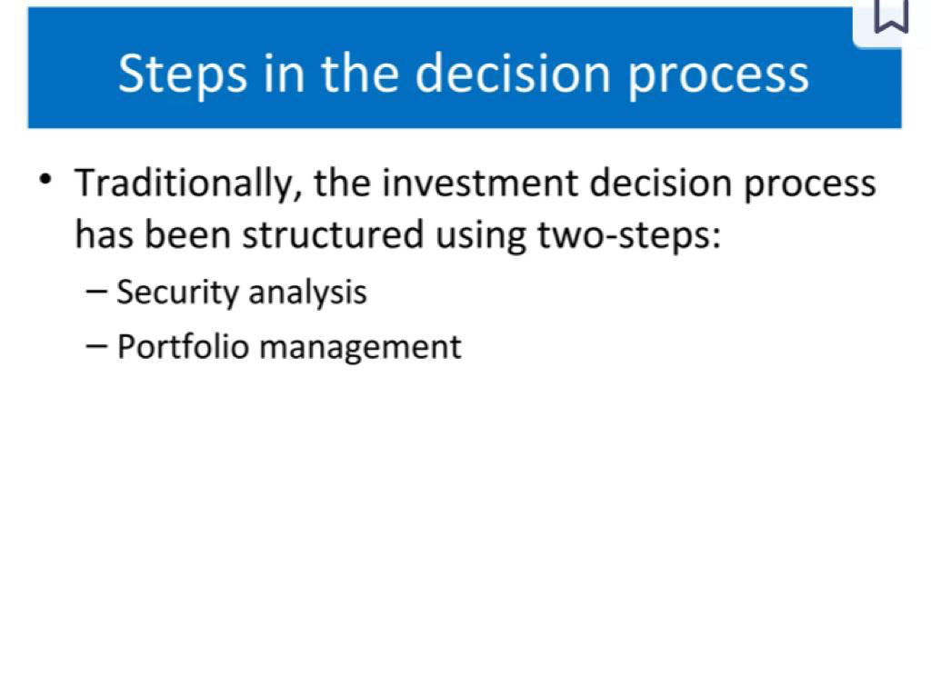
B.Com (H) VI Semester Fundamentals of Investment

Slide 21
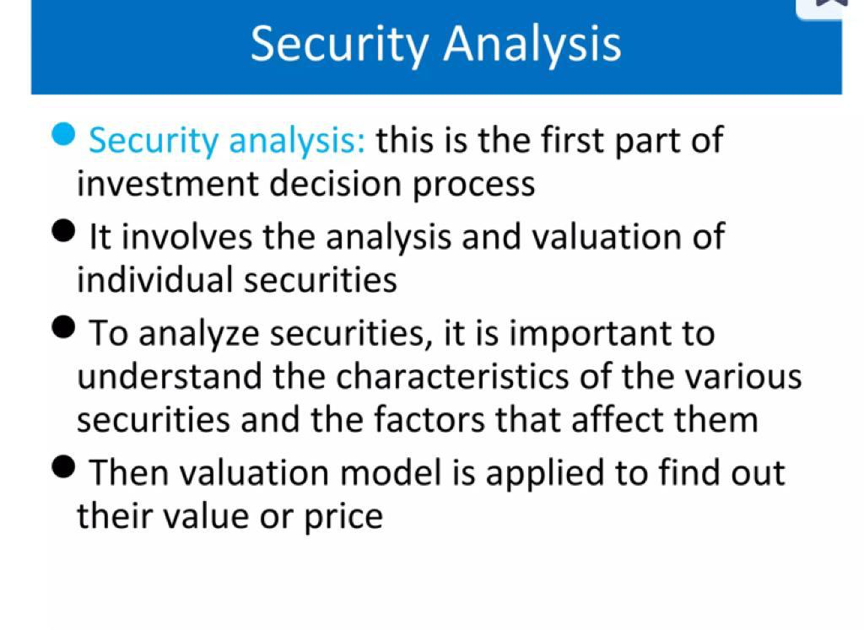
B.Com (H) VI Semester Fundamentals of Investment

Slide 22
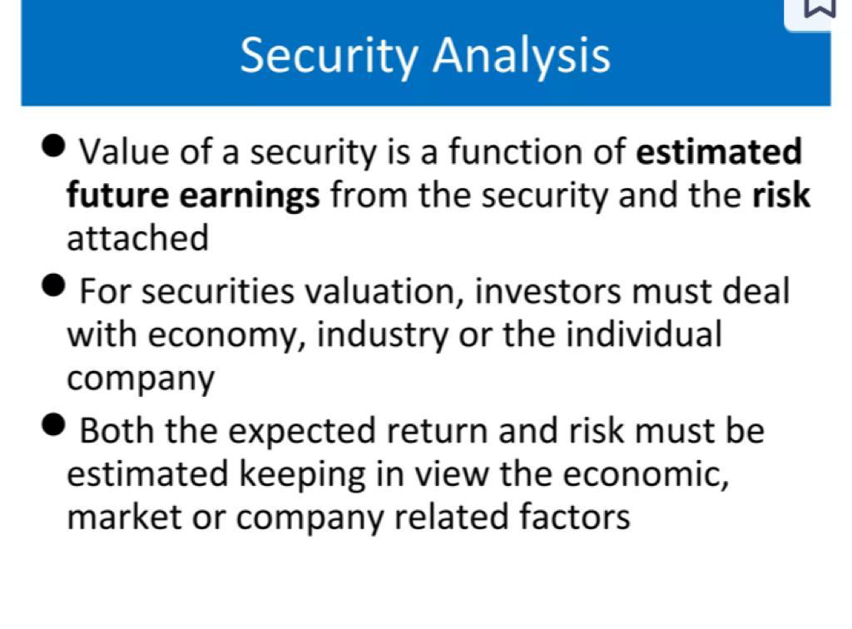
B.Com (H) VI Semester Fundamentals of Investment

Slide 23
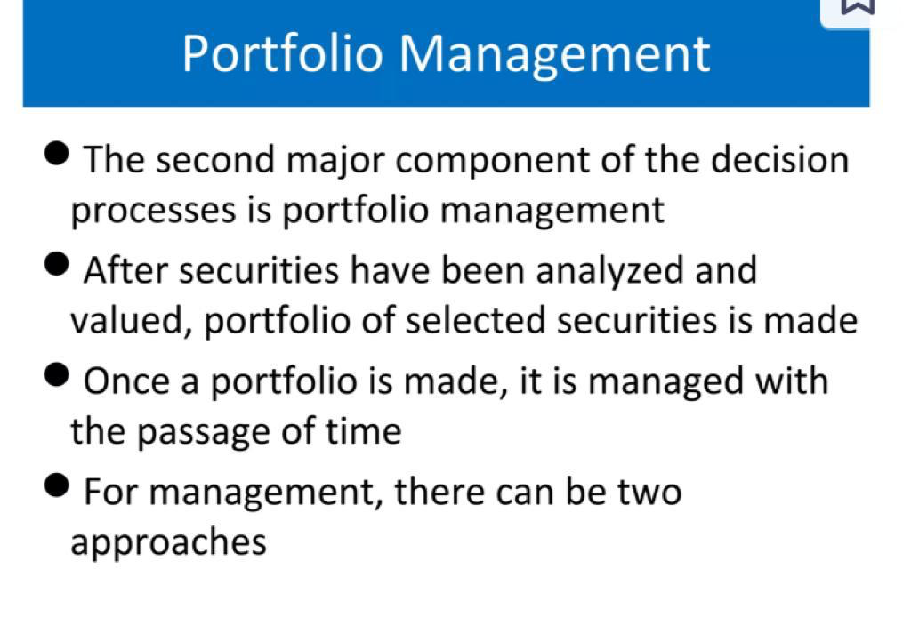
B.Com (H) VI Semester Fundamentals of Investment

Slide 24
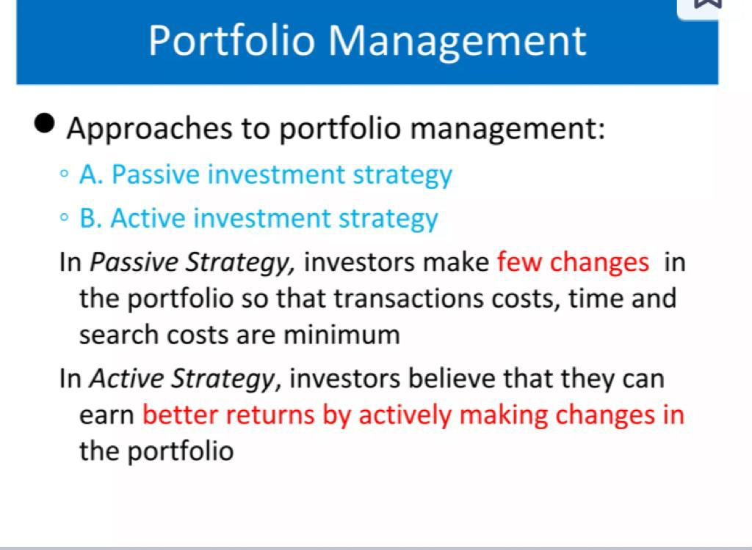
B.Com (H) VI Semester Fundamentals of Investment

Slide 25
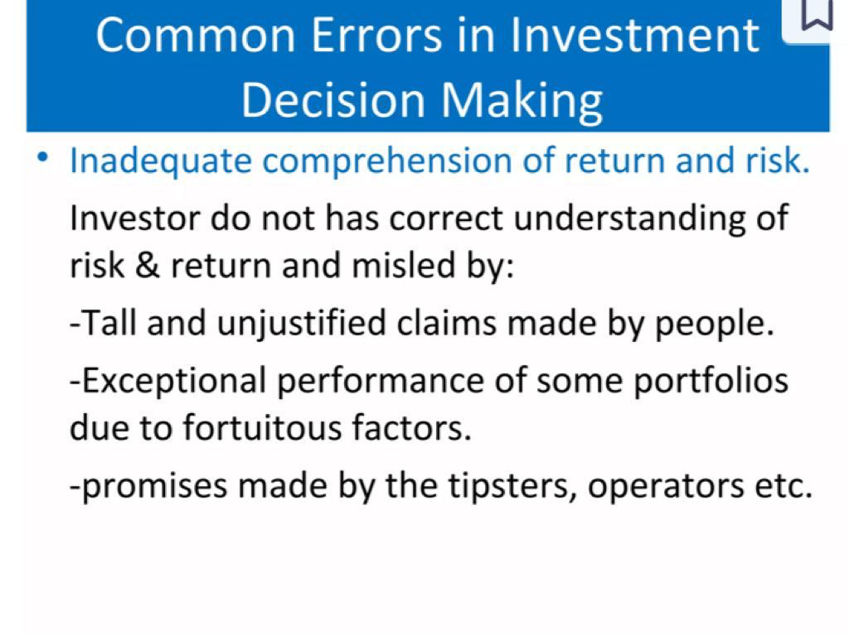
B.Com (H) VI Semester Fundamentals of Investment

Slide 26
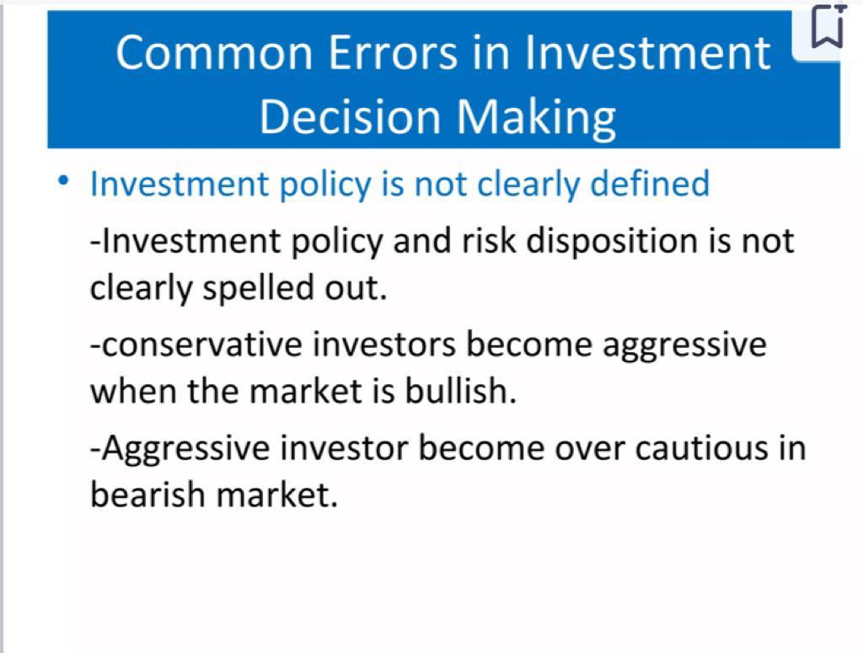
B.Com (H) VI Semester Fundamentals of Investment

Slide 27
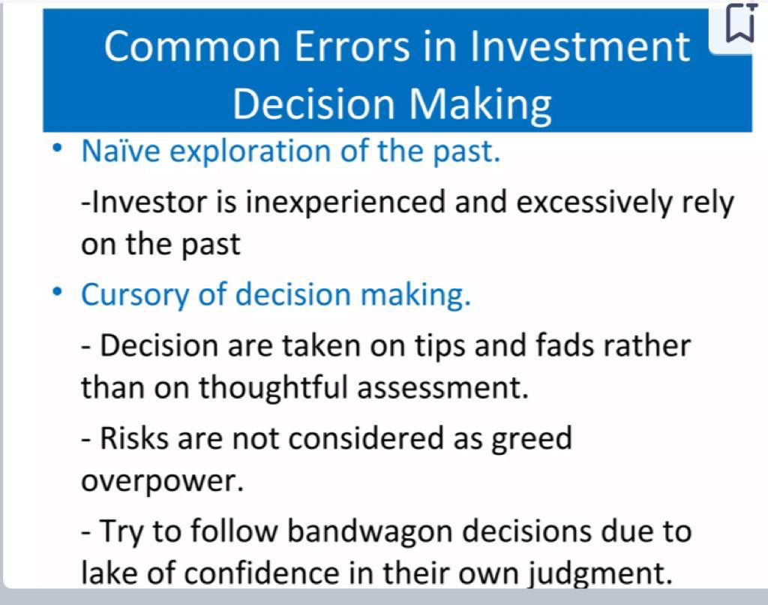
B.Com (H) VI Semester Fundamentals of Investment

Slide 28
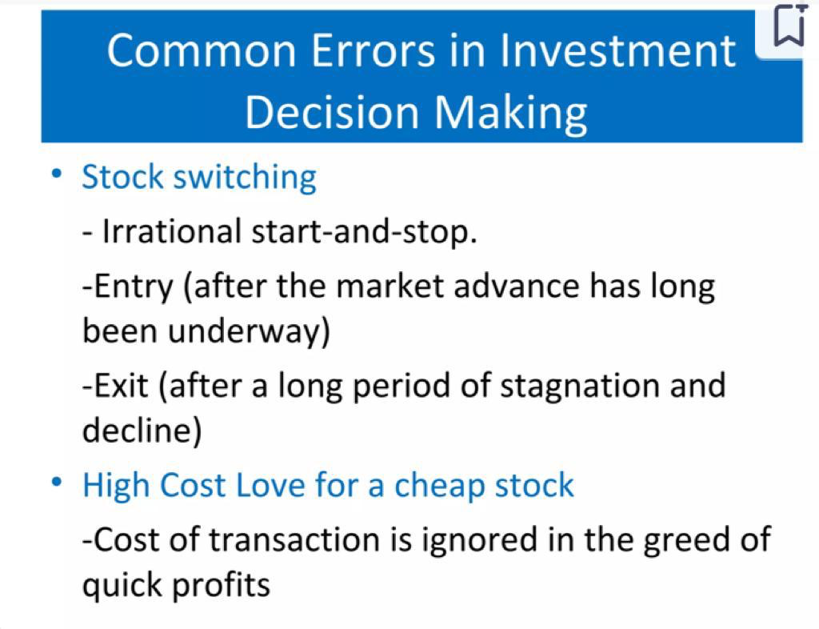
B.Com (H) VI Semester Fundamentals of Investment

Slide 29
Alternative Forms of Investment
B.Com (H) VI Semester Fundamentals of Investment

Slide 30
Government Securities
Types of Securities
Promissory Notes
Stock Certificates
B.Com (H) VI Semester Fundamentals of Investment

Slide 31
Life Insurance
Features of Life Insurance
Element of Protection
Element of Investment
B.Com (H) VI Semester Fundamentals of Investment

Slide 32
UTI
Objectives of investing in Units
Safety
Growth in Dividends
Liquidity
B.Com (H) VI Semester Fundamentals of Investment

Slide 33
Commercial Banks
Savings Bank account
Current account
Recurring Deposits
Fixed Deposit Schemes
B.Com (H) VI Semester Fundamentals of Investment

Slide 34
Provident Fund
Statutory Provident Fund
Recognised Provident Fund
Unrecognised Provident Fund
Public Provident Fund
B.Com (H) VI Semester Fundamentals of Investment

Slide 35
Trading of Securities in the Indian Securities Market
B.Com (H) VI Semester Fundamentals of Investment

Slide 36
Trading of Securities in the Indian Securities Market
Equity Trading
Bond Trading
Derivatives Trading
Commodity Trading
Mutual Fund Investments
B.Com (H) VI Semester Fundamentals of Investment

Slide 37
Trading of Securities in the Indian Securities Market
Algorithmic Trading:
High-Frequency Trading (HFT):
Margin Trading
Short Selling
Block Deals
Market Orders and Limit Orders
After-Hours Trading
B.Com (H) VI Semester Fundamentals of Investment

Slide 38
Equity Trading:
Definition: The buying and selling of company shares representing ownership in the issuing company.
- Example: An investor purchasing shares of Tata Motors on the National Stock Exchange (NSE) with the expectation of benefiting from potential price appreciation.
B.Com (H) VI Semester Fundamentals of Investment

Slide 39
Bond Trading:
Definition: The buying and selling of debt securities that pay periodic interest and return the principal at maturity.
- Example: A trader buying government bonds on the Bombay Stock Exchange (BSE) to earn interest income and potentially benefit from changes in bond prices.
B.Com (H) VI Semester Fundamentals of Investment

Slide 40
Derivatives Trading:
Definition: Involves financial contracts, such as futures and options, whose value is derived from an underlying asset.
- Example: A speculator using Nifty futures on the NSE to bet on the future direction of the Nifty 50 index.
B.Com (H) VI Semester Fundamentals of Investment

Slide 41
Commodity Trading:
Definition: Involves the buying and selling of physical goods or commodity futures contracts.
- Example: A trader on a commodity exchange like Multi Commodity Exchange (MCX) buying gold futures as a hedge against inflation.
B.Com (H) VI Semester Fundamentals of Investment

Slide 42
Currency Trading:
Definition: The buying and selling of foreign currencies in the foreign exchange market.
- Example: An importer using the forex market to exchange Indian Rupees for US Dollars to pay for imported goods.
B.Com (H) VI Semester Fundamentals of Investment

Slide 43
Mutual Fund Investments:
Definition: Investors pool funds, managed by Asset Management Companies (AMCs), to invest in a diversified portfolio of stocks and bonds.
- Example: An individual investing in an HDFC Mutual Fund, which holds a mix of equities and debt instruments
B.Com (H) VI Semester Fundamentals of Investment

Slide 44
Algorithmic Trading:
Definition: Uses computer algorithms to execute high-speed and large-volume trades based on predefined criteria.
- Example: Institutional investors employing algorithmic trading strategies to capitalize on market inefficiencies or execute trades at optimal prices.
B.Com (H) VI Semester Fundamentals of Investment

Slide 45
High-Frequency Trading (HFT):
Definition: Involves executing a large number of orders at extremely high speeds using algorithms.
- Example: HFT firms engaging in rapid buying and selling of securities on electronic exchanges to exploit short-term price discrepancies.
B.Com (H) VI Semester Fundamentals of Investment

Slide 46
Margin Trading:
Definition: Borrowing funds to trade more securities than the investor's capital allows.
- Example: An investor using margin to buy additional shares beyond the available cash balance, amplifying both gains and losses.
B.Com (H) VI Semester Fundamentals of Investment

Slide 47
Short Selling:
- Definition: Selling securities that one does not own with the expectation of buying them back later at a lower price.
- Example: A trader on the NSE selling shares of a company, anticipating a decline in the stock price, with the intention to repurchase them at a lower price.
B.Com (H) VI Semester Fundamentals of Investment

Slide 48
Block Deals:
Definition: Large trades involving a significant number of shares or a substantial value.
- Example: A mutual fund executing a block deal to buy or sell a substantial quantity of shares in a single transaction.
B.Com (H) VI Semester Fundamentals of Investment

Slide 49
Market Orders and Limit Orders:
Definition: Market orders are executed at the current market price, while limit orders are executed at a specified or better price.
- Example: An investor placing a market order to buy shares immediately or a limit order with a specific price condition.
B.Com (H) VI Semester Fundamentals of Investment

Slide 50
After-Hours Trading:
- Definition: Trading that occurs after the regular market hours.
- Example: Some stock exchanges allow extended trading hours where investors can continue buying and selling securities
B.Com (H) VI Semester Fundamentals of Investment

Slide 51
Sources of Financial Information in the Indian Securities Market
B.Com (H) VI Semester Fundamentals of Investment

Slide 52
Financial Newspapers and Magazines
Examples: The Economic Times, Business Standard, and Financial Express.
- Details: These publications provide daily updates on market trends, stock prices, and analyses of economic and financial events. Investors often rely on these sources for news and insights affecting the securities market.

Slide 53
Television Channels
Examples: CNBC-TV18, ET Now, and NDTV Profit.
- Details: Business news channels offer real-time market updates, expert opinions, and interviews with market participants. Investors can stay informed about market movements and economic developments through these broadcasts.

Slide 54
Financial Websites
Examples: Moneycontrol, BloombergQuint, and Livemint.
- Details: Online platforms offer a wealth of financial information, including live stock quotes, market analysis, company financials, and economic indicators. Investors can access these websites for comprehensive financial data and news.

Slide 55
Stock Exchanges
Examples: National Stock Exchange (NSE) and Bombay Stock Exchange (BSE).
- Details: Stock exchanges provide real-time stock prices, trading volumes, and corporate announcements. Investors can access the official websites of these exchanges for up-to-date information on listed companies.
B.Com (H) VI Semester Fundamentals of Investment

Slide 56
Corporate Announcements and Reports
Examples: Annual reports, quarterly results, and press releases.
- Details: Companies release financial statements, annual reports, and updates on their performance. Investors analyze these documents to assess a company's financial health, strategy, and outlook.
B.Com (H) VI Semester Fundamentals of Investment

Slide 57
Regulatory Filings
Examples: Filings with the Securities and Exchange Board of India (SEBI).
- Details: Companies are required to file various disclosures and reports with SEBI. These filings include details about shareholding patterns, insider trading, and other regulatory compliance matters.
B.Com (H) VI Semester Fundamentals of Investment

Slide 58
Brokerage Reports
Examples: Reports from brokerage houses like Motilal Oswal, HDFC Securities, and ICICI Direct.
- Details: Brokerage firms publish research reports on individual stocks, sectors, and market trends. Investors use these reports for insights into investment opportunities and risks.
B.Com (H) VI Semester Fundamentals of Investment

Slide 59
Credit Rating Agencies
Examples: CRISIL, ICRA, and CARE.
- Details: Credit rating agencies assess the creditworthiness of companies and debt instruments. Investors refer to credit ratings to evaluate the risk associated with investing in specific bonds or other debt securities.
B.Com (H) VI Semester Fundamentals of Investment

Slide 60
Financial Analysts and Experts
Examples: Market analysts, economists, and financial experts.
- Details: Insights from financial analysts and experts are often featured in various media. Investors follow their commentaries and analyses for a deeper understanding of market dynamics and investment strategies.
B.Com (H) VI Semester Fundamentals of Investment

Slide 61
Online Financial Portals and Apps
Examples: Moneycontrol app, StockEdge, and Investing.com.
- Details: Mobile apps and online portals offer a user-friendly interface to track stock prices, create watchlists, and access financial news. Investors can use these platforms for quick updates and research on the go.
B.Com (H) VI Semester Fundamentals of Investment

Slide 62
Educational Institutions and Seminars
Examples: Seminars and workshops organized by institutions like NSE and BSE.
- Details: Educational events provide investors with opportunities to learn about market trends, investment strategies, and financial instruments from industry experts.
B.Com (H) VI Semester Fundamentals of Investment

Slide 63
Government Publications
Examples: Reports from the Reserve Bank of India (RBI) and Ministry of Finance.
- Details: Government publications contain economic indicators, monetary policy updates, and fiscal measures that can impact the overall financial landscape.
B.Com (H) VI Semester Fundamentals of Investment

Slide 64
Investor Relations Websites
Examples: Company websites and dedicated investor relations sections.
- Details: Many listed companies maintain sections on their websites dedicated to investor relations. These sections provide access to financial reports, presentations, and updates directly from the companies.
B.Com (H) VI Semester Fundamentals of Investment

Slide 65
SEBI Website
Details: The Securities and Exchange Board of India (SEBI) website is a valuable resource for regulatory updates, circulars, and guidelines. Investors can find information about market regulations and recent developments.
B.Com (H) VI Semester Fundamentals of Investment

Slide 66
Earnings Call Transcripts
Examples: Platforms like Seeking Alpha.
- Details: Earnings call transcripts provide verbatim records of company executives discussing financial results, strategies, and addressing analysts' questions during quarterly earnings calls.
B.Com (H) VI Semester Fundamentals of Investment

Slide 67
Financial News Apps
Examples: Bloomberg, Moneycontrol, and Economic Times.
- Details: Mobile applications provide real-time news updates, market analyses, and personalized alerts. Investors can customize notifications based on their preferences and portfolios.
B.Com (H) VI Semester Fundamentals of Investment

Slide 68
Social Media Platforms
Examples: Twitter, StockTwits, and LinkedIn.
- Details: Social media platforms offer a real-time stream of market discussions, news, and insights. Investors often follow financial influencers, analysts, and companies for timely updates and discussions.
B.Com (H) VI Semester Fundamentals of Investment

Slide 69
Podcasts and Webinars
Examples: Financial podcasts and webinars by industry experts.
- Details: Audio and video content provide an alternative way for investors to stay informed. Podcasts and webinars cover market trends, investment strategies, and interviews with professionals.
B.Com (H) VI Semester Fundamentals of Investment

Slide 70
Stock Screeners
Examples: Screener.in, Moneycontrol's Stock Screener.
- Details: Stock screeners help investors filter and analyze stocks based on various parameters such as financial ratios, market capitalization, and dividend yield.
B.Com (H) VI Semester Fundamentals of Investment

Slide 71
Technical Analysis Platforms
Examples: TradingView, ChartInk.
- Details: Platforms dedicated to technical analysis provide charts, technical indicators, and analysis tools for investors and traders studying price movements and patterns.
B.Com (H) VI Semester Fundamentals of Investment

Slide 72
Sectoral Reports
Examples: Industry reports from research organizations.
- Details: Reports focused on specific sectors provide in-depth analyses of industry trends, challenges, and opportunities. These reports aid investors in understanding the broader economic landscape.
B.Com (H) VI Semester Fundamentals of Investment

Slide 73
Financial Blogs
Examples: Market experts' blogs and investment forums.
- Details: Independent financial bloggers often share market insights, analysis, and personal experiences. Investment forums allow users to discuss various investment strategies and opportunities.
B.Com (H) VI Semester Fundamentals of Investment

Slide 74
Financial Events and Conferences
Examples: Annual general meetings (AGMs) and industry conferences.
- Details: Events and conferences provide opportunities for investors to hear directly from company management, industry leaders, and experts, gaining valuable insights into market trends and developments.
These additional sources complement traditional channels, offering investors a diverse set of tools and information to make well-informed decisions in the Indian securities market.
B.Com (H) VI Semester Fundamentals of Investment

Slide 75
Market Participants in the Indian Securities Market
B.Com (H) VI Semester Fundamentals of Investment

Slide 76
Retail Investors:
- Definition: Individuals who invest relatively small amounts of money in the securities market.
- Example: A person purchasing a few shares of a popular company like Infosys through an online brokerage account.
B.Com (H) VI Semester Fundamentals of Investment

Slide 77
Institutional Investors:
Definition: Large organizations that pool and invest money on behalf of their members or clients.
- Example: Mutual funds, insurance companies, and pension funds investing in a diversified portfolio of stocks and bonds.
B.Com (H) VI Semester Fundamentals of Investment

Slide 78
Foreign Institutional Investors (FIIs):
Definition: Overseas institutions investing in the Indian securities market.
- Example: A hedge fund based in the United States buying shares of an Indian company listed on the Bombay Stock Exchange.
B.Com (H) VI Semester Fundamentals of Investment

Slide 79
Brokers:
Definition: Intermediaries facilitating the buying and selling of securities on behalf of investors.
- Example: Zerodha, ICICI Securities, and Sharekhan are brokerage firms allowing investors to execute trades on stock exchanges.
B.Com (H) VI Semester Fundamentals of Investment

Slide 80
Depositories
Definition: Organizations responsible for holding and transferring securities in electronic form.
- Example: National Securities Depository Limited (NSDL) and Central Depository Services Limited (CDSL) in India maintain electronic records of ownership for traded securities.
B.Com (H) VI Semester Fundamentals of Investment

Slide 81
Stock Exchanges:
Definition: Platforms where securities are bought and sold.
- Example: National Stock Exchange (NSE) and Bombay Stock Exchange (BSE) are the primary stock exchanges in India.
B.Com (H) VI Semester Fundamentals of Investment

Slide 82
Regulators
Definition: Authorities overseeing and regulating the functioning of the securities market.
- Example: Securities and Exchange Board of India (SEBI) regulates activities in the Indian securities market, ensuring fair practices and investor protection.
B.Com (H) VI Semester Fundamentals of Investment

Slide 83
Market Makers:
Definition: Entities that provide liquidity by quoting bid and ask prices for securities.
- Example: Investment banks or specialized market-making firms facilitate trading by being willing to buy or sell securities at publicly quoted prices.
B.Com (H) VI Semester Fundamentals of Investment

Slide 84
Clearing Corporations:
Definition: Organizations responsible for ensuring the settlement of trades by clearing and settling transactions.
- Example: National Securities Clearing Corporation Limited (NSCCL) for the NSE ensures the smooth settlement of trades executed on the exchange.
B.Com (H) VI Semester Fundamentals of Investment

Slide 85
Credit Rating Agencies:
Definition: Agencies assessing the creditworthiness of issuers and their securities.
- Example: CRISIL, ICRA, and CARE are credit rating agencies in India that provide ratings for bonds and other debt instruments.
B.Com (H) VI Semester Fundamentals of Investment

Slide 86
Investment Bankers:
Definition: Financial institutions involved in underwriting and facilitating the issuance of securities.
- Example: Axis Capital, Kotak Investment Banking, and SBI Capital Markets play roles in bringing companies to the primary market through activities like IPOs.
B.Com (H) VI Semester Fundamentals of Investment

Slide 87
Arbitrageurs
Definition: Traders who exploit price differences in different markets or securities.
- Example: An arbitrageur might simultaneously buy and sell the same security in different markets to profit from short-term price discrepancies.
B.Com (H) VI Semester Fundamentals of Investment

Slide 88
Hedge Funds:
Definition: Investment funds that employ various strategies to generate returns.
- Example: A hedge fund may use strategies like short selling or derivatives trading in the securities market to achieve its investment goals.
B.Com (H) VI Semester Fundamentals of Investment

Slide 89
Risk
B.Com (H) VI Semester Fundamentals of Investment

Slide 90
Risk
Systematic Risk
Unsystematic Risk
B.Com (H) VI Semester Fundamentals of Investment

Slide 91
Systematic Risk
Market Risk
Interest Rate Risk
Purchasing Power Risk
B.Com (H) VI Semester Fundamentals of Investment

Slide 92
Unsystematic Risk
Business Risk
Financial Risk
B.Com (H) VI Semester Fundamentals of Investment

Slide 93
Quantitative Analysis of Risk
Standard Deviation and Variance- The most useful method for calculating the variability is the standard deviation and variance.
B.Com (H) VI Semester Fundamentals of Investment

Slide 94
Relationship of Risk and Return
There is positive relation between risk and return. The ultimate objective of the investor is to derive a portfolio of securities that meets his preferences for risk and return.

Slide 95
The Indian Securities Market
B.Com (H) VI Semester Fundamentals of Investment

Slide 96
Industrial Securities
Equity Shares or Ordinary shares
Preference Shares
Debentures
B.Com (H) VI Semester Fundamentals of Investment

Slide 97
Markets
New Issues Market
The Stock Market
Commodity Market
B.Com (H) VI Semester Fundamentals of Investment

Slide 98
Important Stock Markets in India
National Stock Exchange
Bombay Stock Exchange
Over the counter exchange of India
Inter-connected Stock Exchange
National Commodity and Derivatives Exchange Limited
B.Com (H) VI Semester Fundamentals of Investment

Slide 99
Financial Institutions
Reserve Bank of India
Banks
Insurance Companies
Investment Banks
Mutual Funds
Hedge Funds
Pension Funds
B.Com (H) VI Semester Fundamentals of Investment

Slide 100
SEBI
SEBI was established in 1988 and was given statutory powers on April 12, 1992, through the SEBI Act, 1992. The main objectives of SEBI are to protect the interests of investors in securities and to promote the development and regulation of the securities market in India.
B.Com (H) VI Semester Fundamentals of Investment

Slide 101
Week 1: Learning Outcome
Learners will learn about the basics of investments, investment alternatives available , Indian securitiies market in terms of capital and money market, stock market indices, market participants and concepts of risk and return

